Slide 1
Word Embeddings
Prof. Sebastián Vallejo Vera

Slide 2
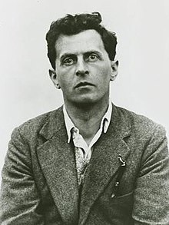
Up until now, we have thought of words as atomic representations of concepts.
Intuitively, we know that this is not the case.
Let’s think for a moment, as we usually do, about Ludwig Wittgenstein

Slide 3
In his Philosophical Investigations (1953), Wittgenstein wrote about language-games, this idea that language is used in context and cannot be understood outside of that context.
Think of the word game: by itself it cannot be understood. But in context:
War games
Board games
Sports
Betting games
“For a large class of cases—though not for all—in which we employ the word ‘meaning,’ it can be defined thus: the meaning of a word is its use in the language.”

Slide 4
This is the distributional hypothesis of language: “you shall know a word by the company it keeps”.
The intuition is as follows:

Slide 5
Cook
i
Chef
Kitchen
Food
Bed
Sleep
Pillow
Mattress
j

Slide 6
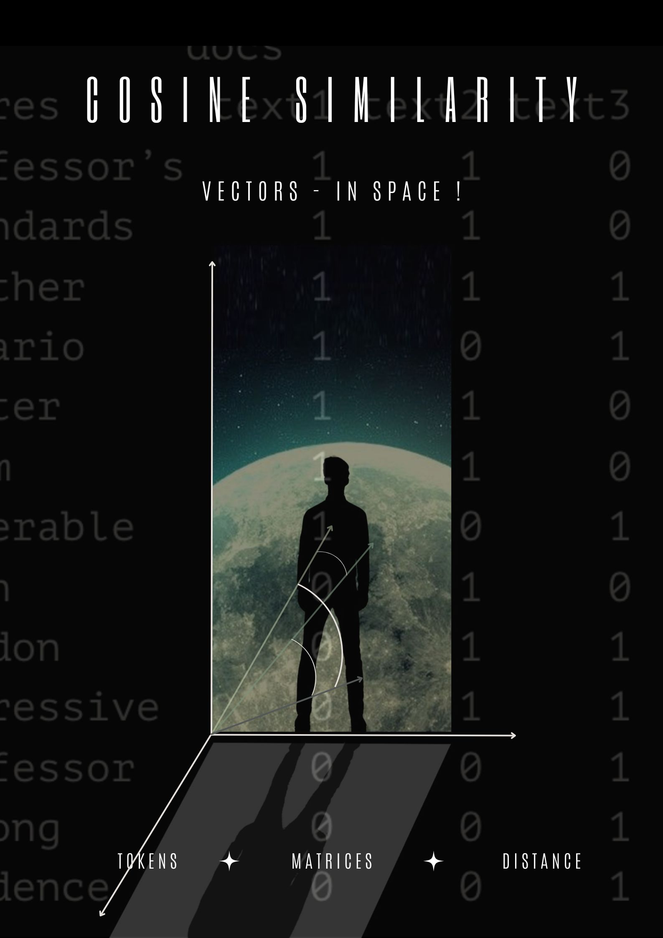

Slide 7
Word Embeddings
With word embeddings we can get a priori meaning of words.
How? By looking at ”the company they keep”, the context in which each word is embedded.

Slide 8
How it works…

Slide 9
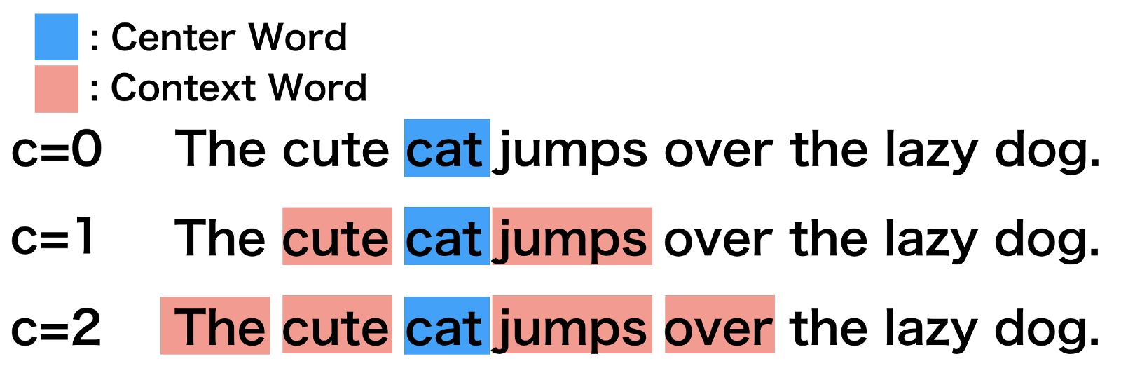

Slide 10
We choose a context window and create a co-occurrence matrix. For example, with a context window of two:
 | The | cute | cat | jumps | over | the | lazy | dog
The | 0 | 1 | 1 | 0 | 0 | 0 | 0 | 0
cute | 1 | 0 | 1 | 1 | 0 | 0 | 0 | 0
cat | 1 | 1 | 0 | 1 | 1 | 0 | 0 | 0
jumps | 0 | 1 | 1 | 0 | 1 | 1 | 0 | 0
over | 0 | 0 | 1 | 1 | 0 | 1 | 1 | 0
the | 0 | 0 | 0 | 1 | 1 | 0 | 1 | 1
lazy | 0 | 0 | 0 | 0 | 1 | 1 | 0 | 1
dog | 0 | 0 | 0 | 0 | 0 | 1 | 1 | 0

Slide 11
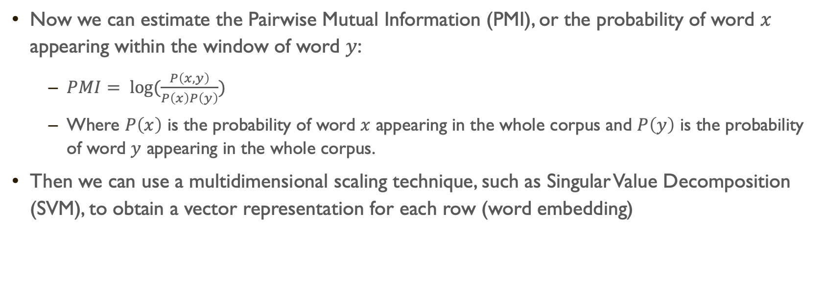
Now we can estimate the Pairwise Mutual Information (PMI), or the probability of word $x$ appearing within the window of word $y$:
$PMI= \log{(\frac{P\left(x,y\right)}{P\left(x\right)P\left(y\right)})}$
Where $P\left(x\right)$ is the probability of word $x$ appearing in the whole corpus and $P\left(y\right)$ is the probability of word $y$ appearing in the whole corpus.
Then we can use a multidimensional scaling technique, such as Singular Value Decomposition (SVM), to obtain a vector representation for each row (word embedding)

Slide 12
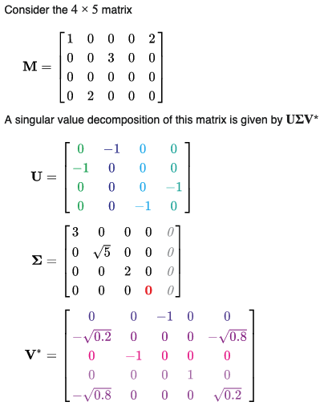

SVM from scholarly journal Wikipedia

Slide 13
You can get better representations if we use a neural-network…

Slide 14
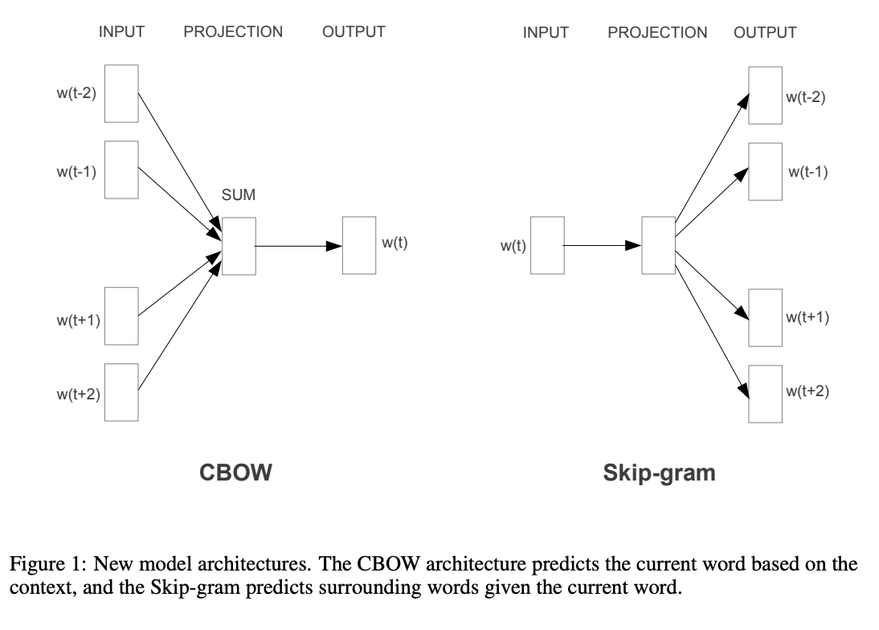

Slide 15
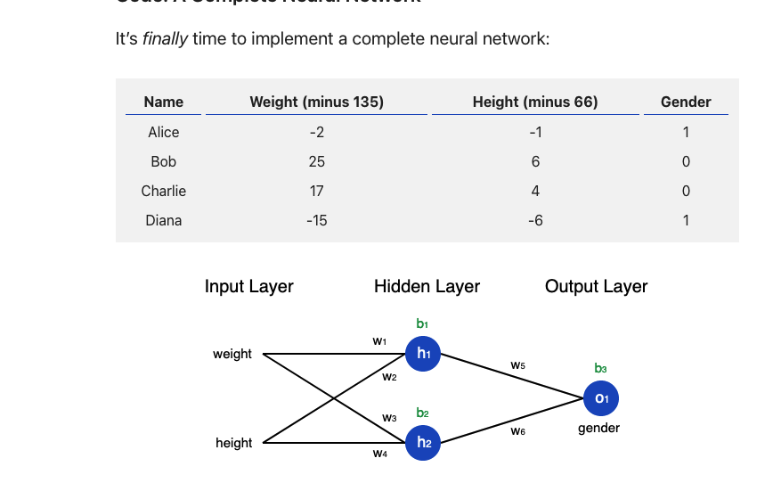
Neural networks…

Slide 16



… but for corpora
$${word}_{t−1}$$
$${word}_{t}$$
$${word}_{t+1}$$

Slide 17

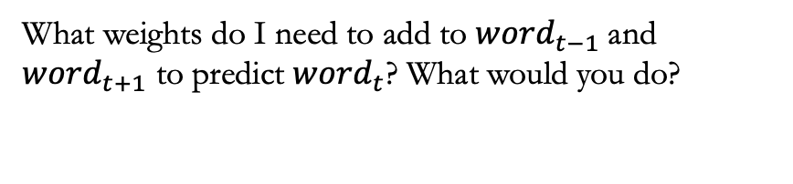
… but for corpora
$${word}_{t−1}$$
$${word}_{t}$$
$${word}_{t+1}$$
What weights do I need to add to ${word}_{t−1}$and ${word}_{t+1}$ to predict ${word}_{t}$? What would you do?

Slide 18
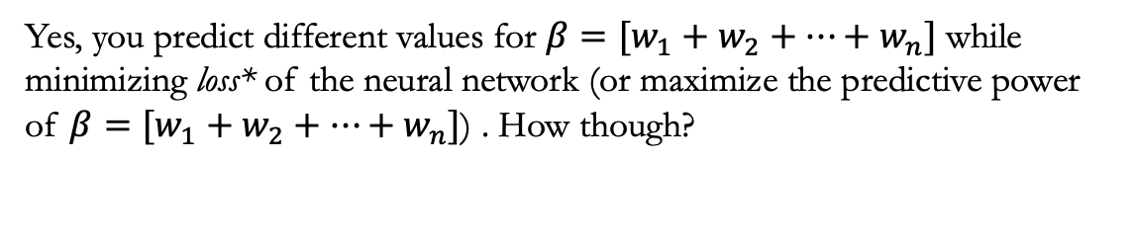
… but for corpora
$${word}_{t−1}$$
$${word}_{t}$$
$${word}_{t+1}$$
Yes, you predict different values for $β=[w_{1}+w_{2}+…+w_{n}]$ while minimizing loss* of the neural network (or maximize the predictive power of $β=[w_{1}+w_{2}+…+w_{n}]$) . How though?

Slide 19
… but for corpora
$${word}_{t−1}$$
$${word}_{t}$$
$${word}_{t+1}$$
Right, again! Using stochastic gradient descent… think about it like MLE but not MLE (since maximizing likelihood is a method of finding the parameters, while neural network is the function defined in terms of those parameters)

Slide 20
… but for corpora
$${word}_{t−1}$$
$${word}_{t}$$
$${word}_{t+1}$$
That’s the word embedding!

Slide 21
So what?

Slide 22

Encoding similarity:
These embedding have nice and intuitive algebraic properties. Thus:

Slide 24
Automatic Generalization
Which also means that, even if I get a word that not often used in MY corpus, the computer can infer the meaning by looking at the embeddings of other words that are close by.

Slide 25
Measuring meaning
As words get closer in spaces there are more similar in meaning… as they get farther, they get more different in meaning…

Slide 26
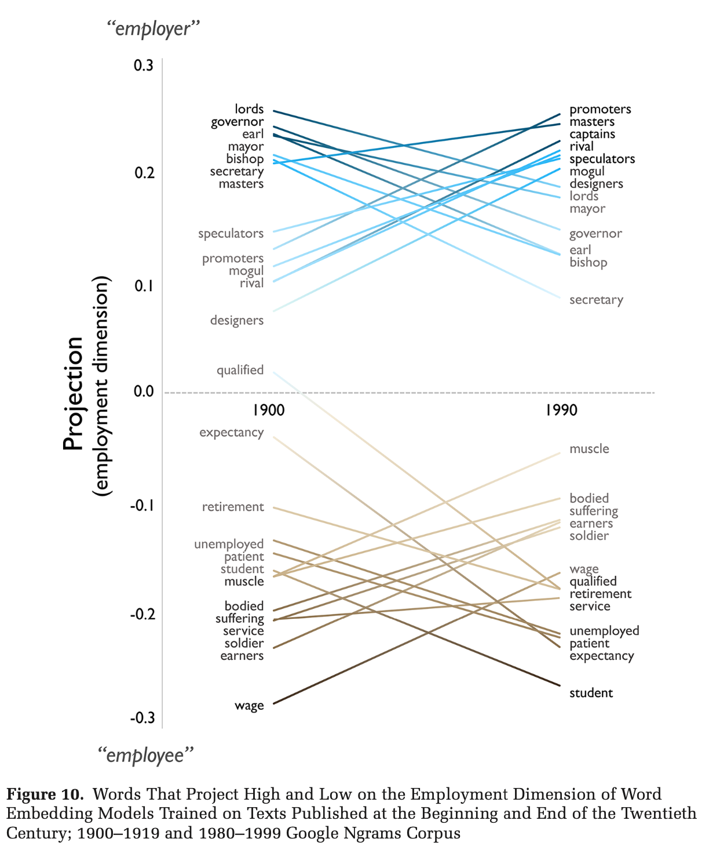

Slide 27
How can we use it? / Why should we care?
There are two general uses for word embeddings:
Use the (variation in the) position of words in relation to each other to make inferences about meaning, ideology, biases, etc. (i.e., unsupervised learning)
Use pre-trained word embeddings to predict categories in text (i.e., supervised learning)

Slide 28
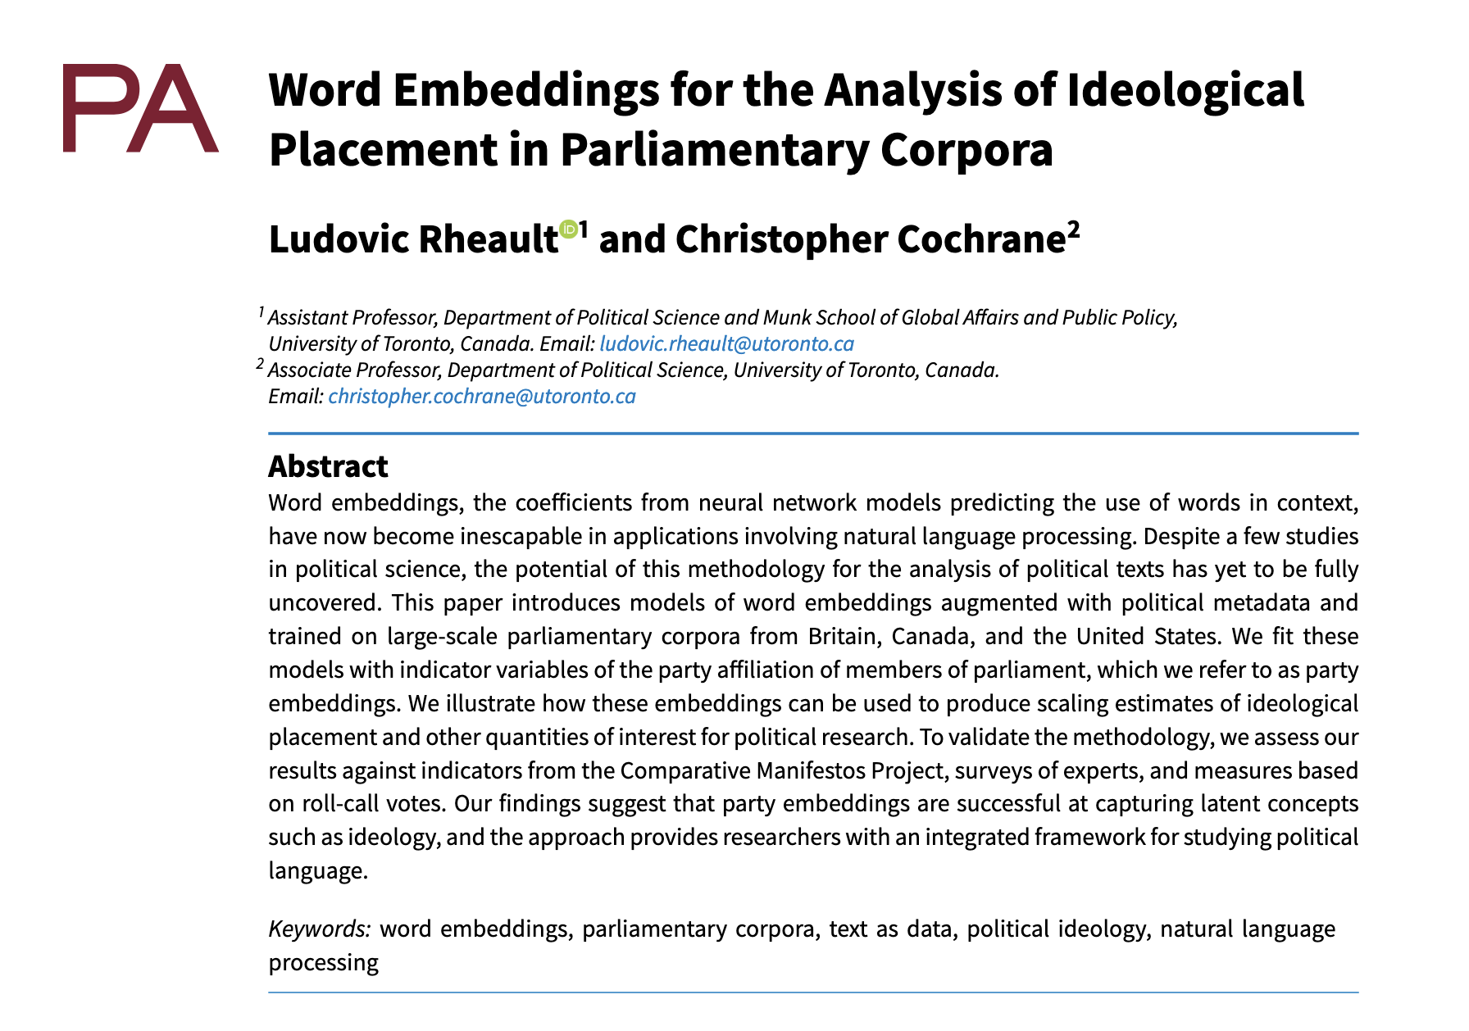
Rheault and Cochrane (2020) – Word Embeddings for the Analysis of Ideological Placement in Parliamentary corpora

Slide 29
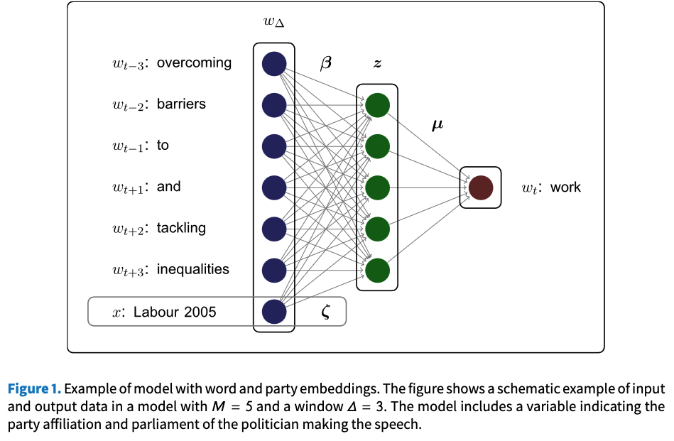

Slide 30
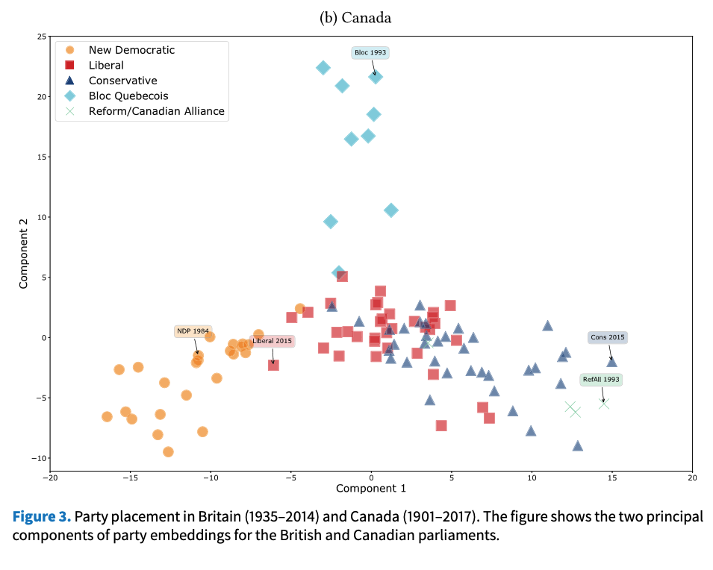

Slide 31
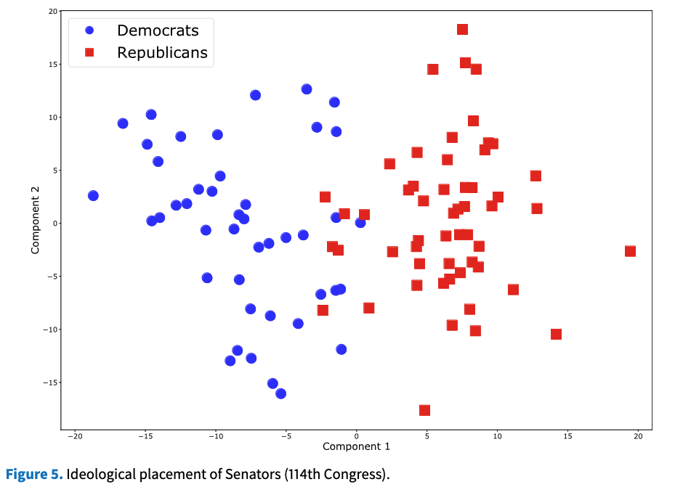

Slide 32
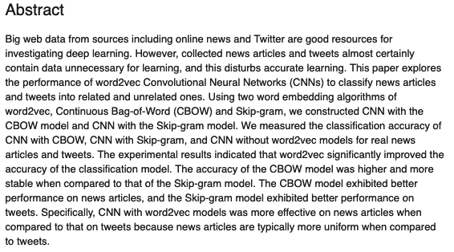
Jang et al. (2019) - Word2vec convolutional neural networks for classification of news articles and tweets

Slide 33
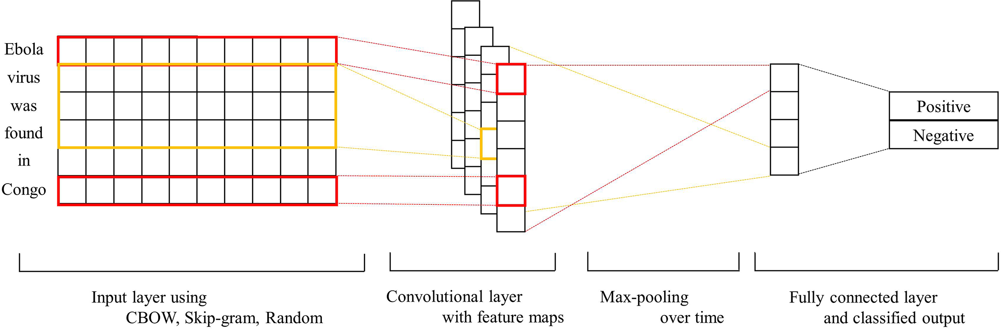

Slide 34
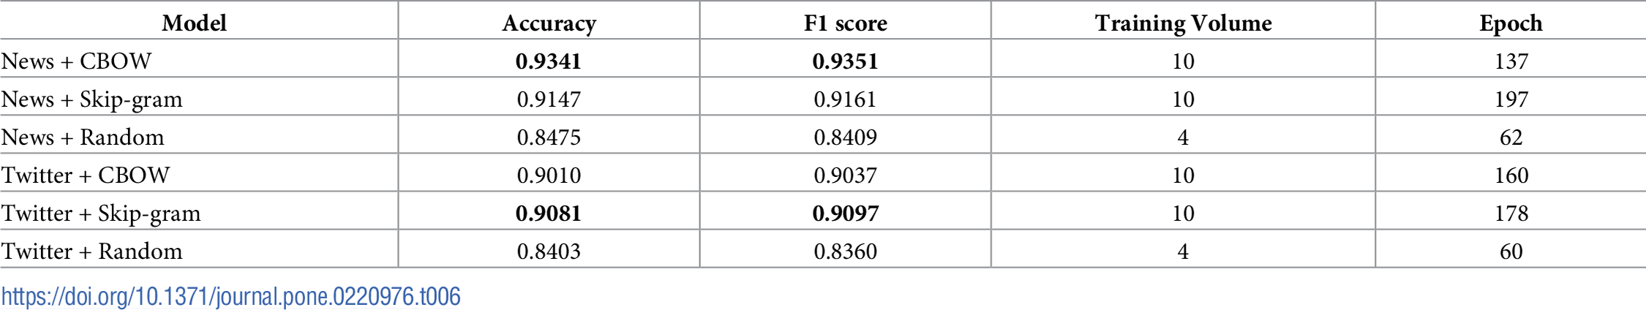

Slide 35
How can we use it? / Why should we care?
There are two general uses for word embeddings:
Use the (variation in the) position of words in relation to each other to make inferences about meaning, ideology, biases, etc. (i.e., unsupervised learning)
Use pre-trained word embeddings to predict categories in text (i.e., supervised learning)
But what if we could get EVEN BETTER representations?

